Slide 1
#Observer Pattern
Intro
Hook
Explore
Explain
Apply
Share
Evaluate
Expand
Presenter:
Huỳnh Lê An Phú – 10421100
Phan Tâm Như - 10421122

Slide 2
#Table of Contents
Intro
Hook
Explore
Explain
Apply
Share
Evaluate
Expand
1. Overview
2. Implementation

Slide 3
The Weather Monitoring application overview
Intro
Hook
Explore
Explain
Apply
Share
Evaluate
Expand
Weather Station Device that receives the weather data
Weather Data Object Tracks the data from the station and updates
Display Show the current weather conditions

Slide 4
Observer Pattern
Intro
Hook
Explore
Explain
Apply
Share
Evaluate
Expand
Definition
The Observer Pattern defines a one-to-many dependency between objects so that when one object changes state, all of its dependents are notified and updated automatically.
Observer Pattern is a behavioral pattern.

Slide 5
Observer Pattern
Intro
Hook
Explore
Explain
Apply
Share
Evaluate
Expand
When to use
When an abstraction has two aspects, one dependent on the other
When a change to one object requires changing others, and you don't know how many objects need to be changed
When an object should be able to notify other objects without making assumptions about who these objects are

Slide 6
Observer Pattern
Intro
Hook
Explore
Explain
Apply
Share
Evaluate
Expand
Pros and Cons
Open/Closed Principle. You can introduce new subscriber classes without having to change the publisher’s code (and vice versa if there’s a publisher interface).
Relations can be established between objects at run time.
Subscribers are notified in random orders.

Slide 7
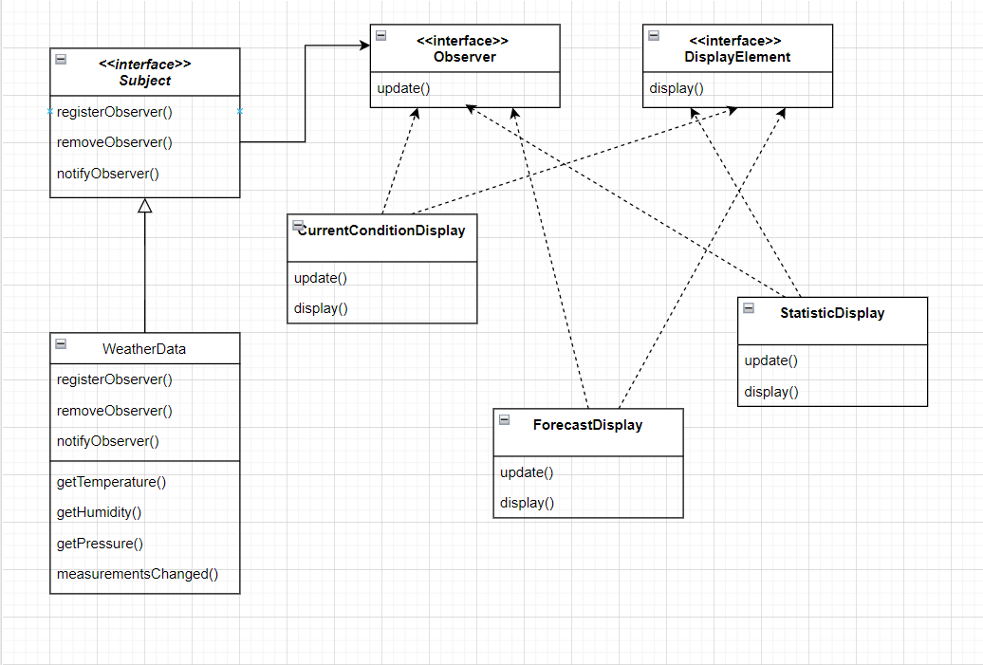
Intro
Hook
Explore
Explain
Apply
Share
Evaluate
Expand
Class Diagram

Slide 8
Explain
Intro
Hook
Explore
Explain
Apply
Share
Evaluate
Expand
Subject
The interface of the app. Objects use this to register as observers and also to remove them from being observers.
Each subject can have many observers.

Slide 9
Explain
Intro
Hook
Explore
Explain
Apply
Share
Evaluate
Expand
WeatherData
Weather data implements the Subject interface.
Contains three methods return the most recent weather measurements.
Every time the weather measurements update, measurementsChanged() is called.

Slide 10
Explain
Intro
Hook
Explore
Explain
Apply
Share
Evaluate
Expand
Observer
All observers need to implement the observer interface.
The update() gets called when the Subject’s state changes.

Slide 11
Description
Intro
Hook
Explore
Explain
Apply
Share
Evaluate
Expand
Create an application that uses weather data Object to update three elements for weather conditions.
Humidity, temperature, and pressure are the three elements that are displayed. The code will update once every 5 seconds.

Slide 12
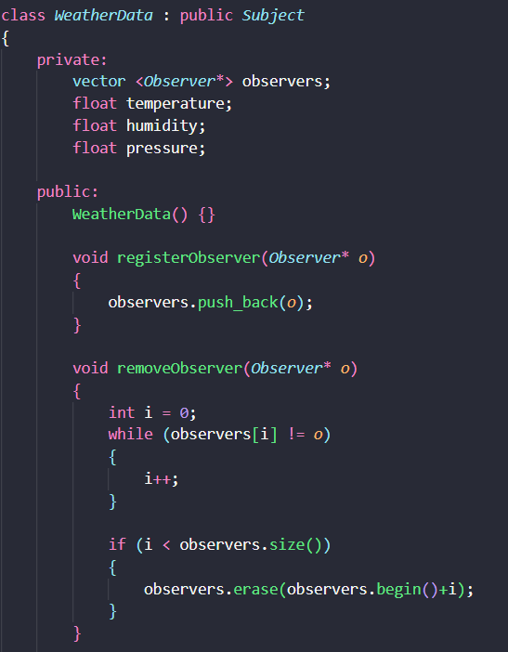
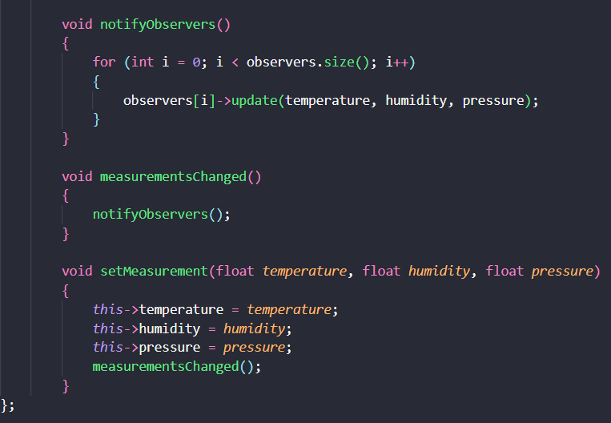
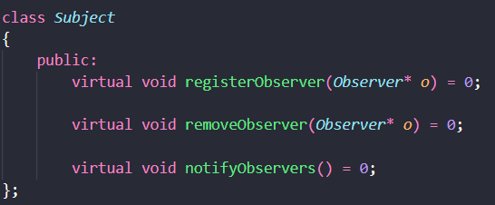
Implementation (Subject)
Intro
Hook
Explore
Explain
Apply
Share
Evaluate
Expand

Slide 13
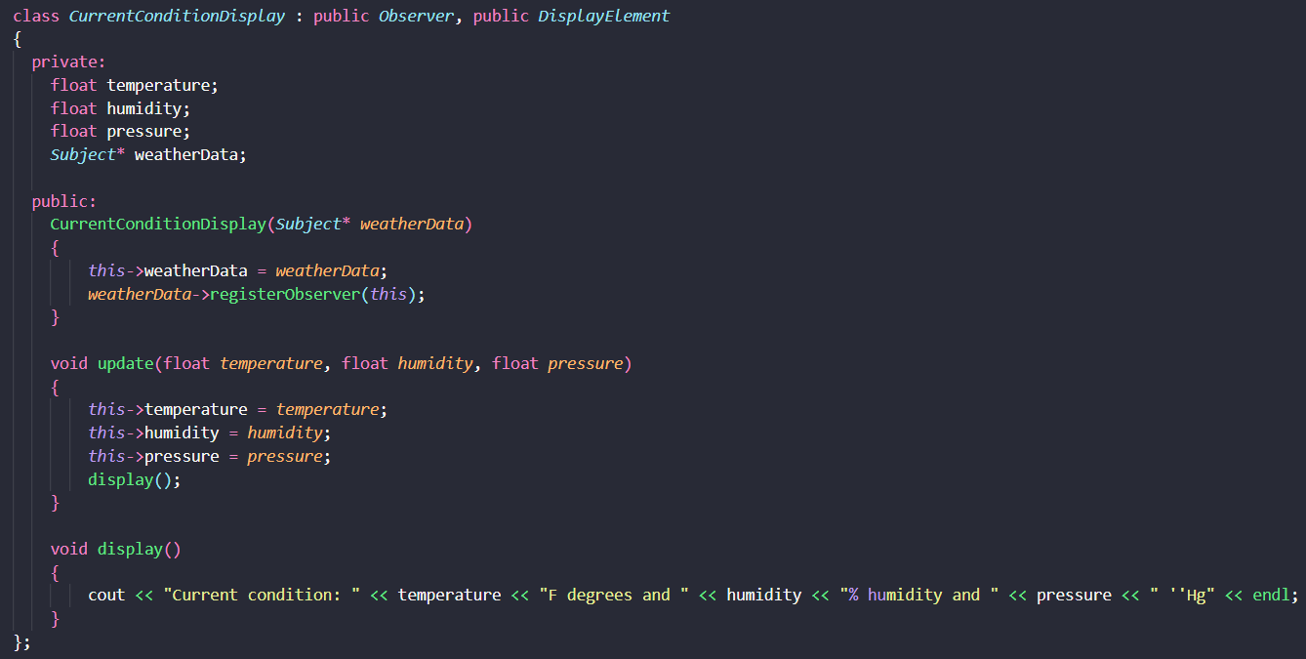
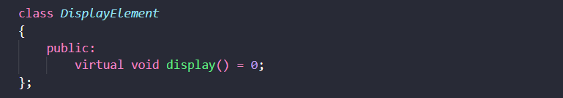
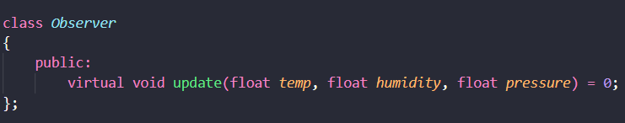
Implementation (Observer)
Intro
Hook
Explore
Explain
Apply
Share
Evaluate
Expand

Slide 14
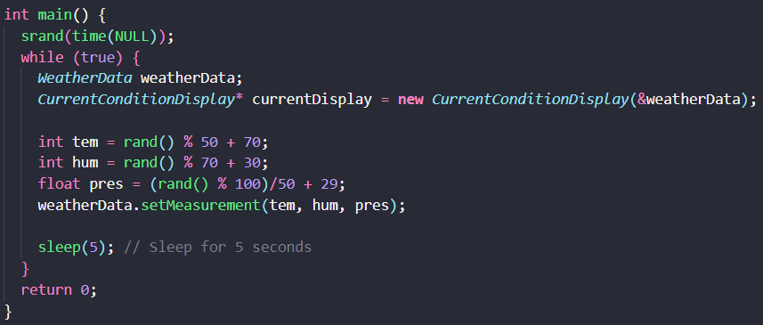
Implementation (main function)
Intro
Hook
Explore
Explain
Apply
Share
Evaluate
Expand

Slide 15
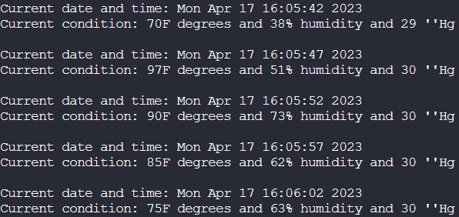
Implementation (output)
Intro
Hook
Explore
Explain
Apply
Share
Evaluate
Expand

Slide 16
#Thanks!

